Slide 1
Time Domain Analysis of
Control Systems
Chapter 3

Slide 2
Review of Last Chapter
How to model a LTI system
  ODE, TF, SE
Pictorial representation of a control system
  Block diagrams
  Signal flow graphs
  State diagrams
How to solve a LTI system
  Time domain method
  s domain method
Stability
  Zero-State & Zero-Input Response
  Liapunov Stability
  Asymptotic Stability
  BIBO Stability

Slide 3
Outlines
Stability
  Stability condition
  Routh-Hurwitz criterion
Steady-state performance
  Definition of time response;
  Typical test signals;
  Performance specifications of steady-state response – steady-state error;
  Impact of disturbance to steady-state error;
  Impact of parameter variation to steady-state error.
Transient Response
  Performance Criteria
  Transient Response of 1st-Order Systems
  Transient Response of 2nd-Order Systems
Notes:
1. Since time is used as an independent variable in most control systems, it is usually of interest to study the state and output response with respect to time, or simply, the time response.

Slide 4
Routh-Hurwitz Criterion
Routh-Hurwitz criterion is an algebraic method that provides information on the absolute stability of a linear time-invariant system.
The system has a characteristic equation with constant coefficients.
The criterion tests whether any of the roots of the characteristic equation lie in the right-half s-plane.
The number of roots lie on the imaginary axis and in the right-half plane is also indicated.

Slide 5
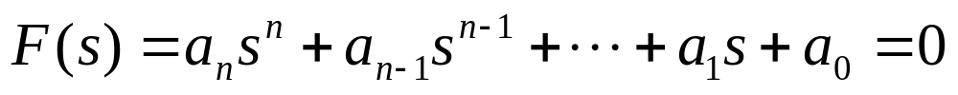
Routh-Hurwitz Criterion
Consider that the characteristic equation of a LTI SISO system is of the form
where all the coefficients are real. In order that the above equation
does not have roots with positive real parts, it is necessary that the
following two conditions hold:
All the coefficient of the equation have the same sign.
None of the coefficients vanishes.

Slide 6
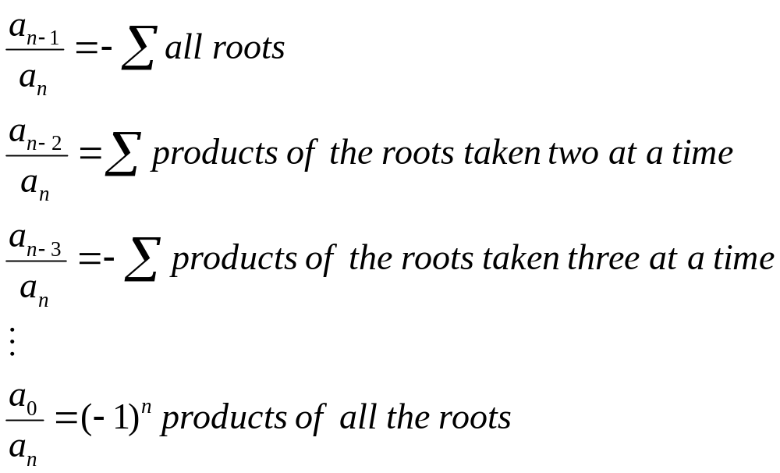
Routh-Hurwitz Criterion
The conditions above are based on the laws of algebra, which related to the coefficients of the above equation as follows:
Notes:
Quadratic equation with one unkown

Slide 7
Routh-Hurwitz Criterion
Remarks
All these ratios must be positive and nonzero unless at least one of the roots has a positive real part.
The two necessary conditions can easily be checked by inspection of the equation. However, these conditions are not sufficient, for it is quite possible that an equation with all its coefficients nonzero and of the same sign still may not have all the roots in the left half of the s-plane

Slide 8

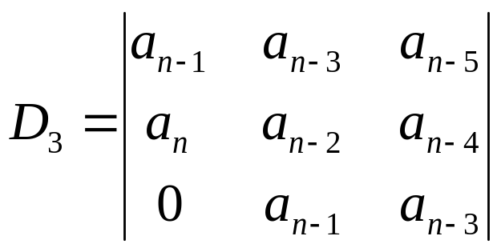
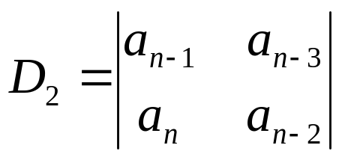
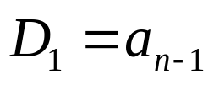
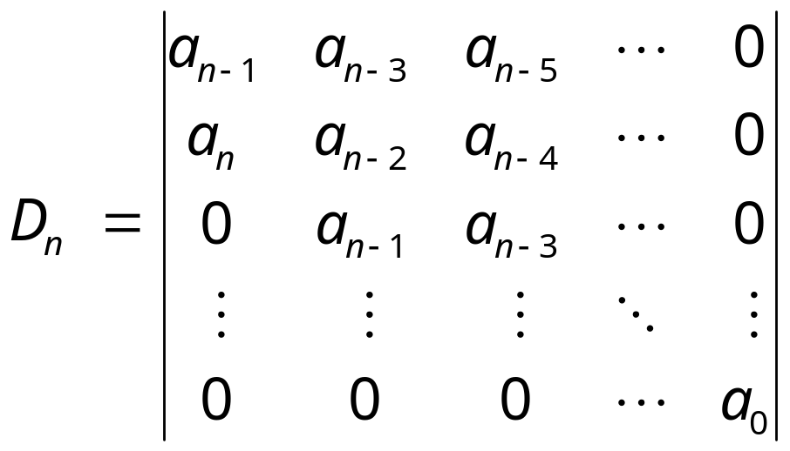
Hurwitz Criterion
The Routh-Hurwitz criterion is based on the Hurwitz criterion, which is stated as follows:
The necessary and sufficient condition that all roots of the characteristic equation lie in the left half of the s-plane is that the equation’s Hurwitz determinant , must all be positive.

Slide 9
Routh-Hurwitz Criterion
Routh-Hurwitz criterion is a simplification of the Hurwitz criterion.
The simplification is made by rearrange the coefficients of the characteristic equation into two rows, and form the following array of numbers by the indicated operations, as illustrated in the next slide.
Notes:
The opposite of matrix determinant

Slide 10










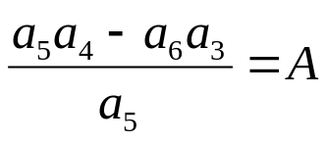
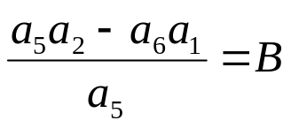
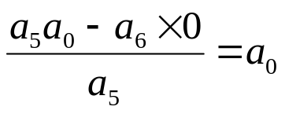


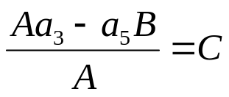
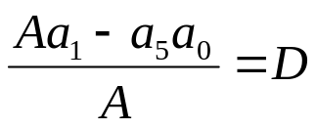
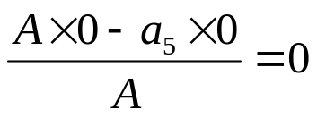

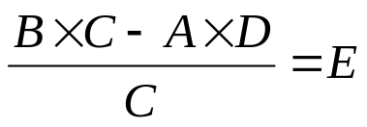
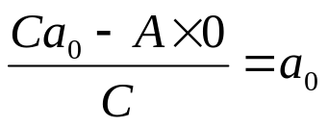
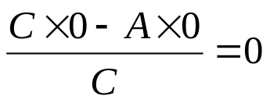

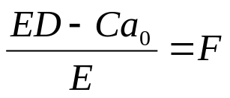

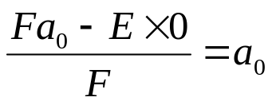
Routh’s Tabulation
Notes:
The opposite of matrix determinant

Slide 11
Routh-Hurwitz Criterion
Sufficient and necessary condition:
The roots of the equation are all in the left-half of the s-plane if all the elements of the first column of the Routh’s tabulation are of the same sign.
The number of changes of signs in the elements of the first column equals the number of roots with positive real parts or in the right-half s-plane.

Slide 12
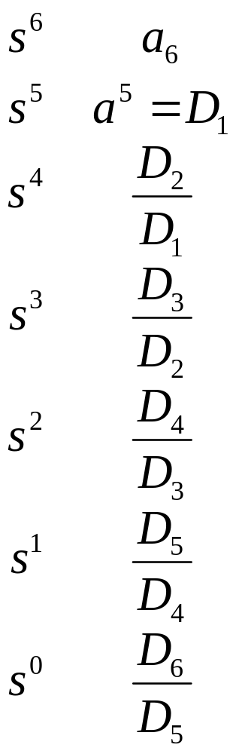
Routh-Hurwitz Criterion
The reason for the foregoing conclusion is simple, based on the requirements of the Hurwitz determinants. The ralations between the elements in the first column of the Routh’s tabulation and the Hurwitz determinants are:

Slide 13
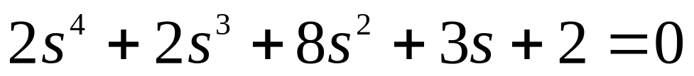
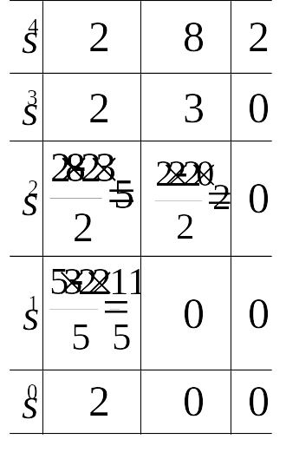
Example – 3.4
Q: Tell the stability of the following system with given characteristic equation.
A: the elements in the first column of the Routh’s tabulation are of
the same sign, the system is stable.

Slide 14
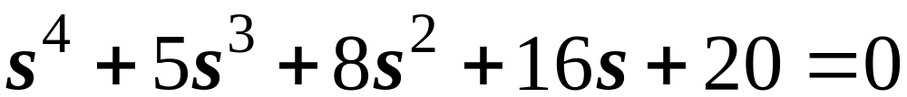
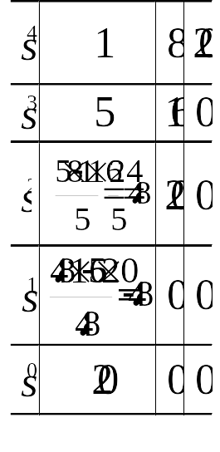
Example – 3.5
Q: Tell the stability of the following system with given characteristic equation.
A: signs of elements in the first column changes twice, there are two
roots in the right-half s-plane. The system is unstable.

Slide 15
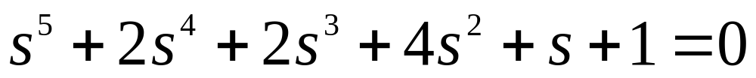
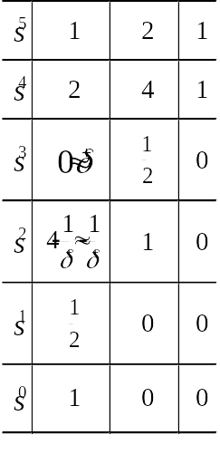
Special Cases When Routh’s Tabulation Terminates Prematurely
The first element in any one row of Routh’s tabulation is zero, but the others are not.

Slide 16


Special Cases When Routh’s Tabulation Terminates Prematurely
It should be noted that the method may not give correct results if the equation has pure imaginary roots.
Further reading is recommended.
K.J. KHATWANI, “On Routh-Hurwitz Criterion,” IEEE Trans.
Automatic Control, Vol. AC-26, p.583, Apr. 1981
S.K. PILLAI, “The Method of the Routh-Hurwitz Criterion,”
IEEE Trans. Automatic Control, Vol. AC-26, p.584, Apr. 1981

Slide 17
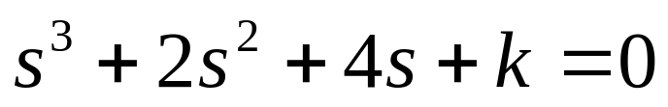






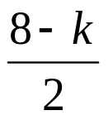





Special Cases When Routh’s Tabulation Terminates Prematurely
The elements in one row of Routh’s tabulation are all zeros.
When
, the elements in
row are all zero.
Auxiliary equation
, which is formed from the coefficients
of the row just above the row of zeros, is needed to continue the
Routh’s tabulation.

Slide 18




Special Cases When Routh’s Tabulation Terminates Prematurely
Concrete steps
Form the auxiliary equation .
Take the derivative of the auxiliary equation respect to s .
Replace the row of zeros with the coefficients of .
Continue the Routh’s tabulation in the usual manner with the newly formed row of coefficients replacing the row of zeros.
Interpret the changes of signs, if any, of the coefficients in the first column.

Slide 19
Remarks about the Auxiliary Equation
That the elements in a row are all zeros indicates that one or more of the following conditions may exist:
  one pair of real roots with equal magnitude but opposite signs;
  one or more pairs of imaginary roots;
  pairs of complex-conjugate roots forming symmetry about the origin of the s-plane.
The roots of the auxiliary equation also satisfy the original equation.
  Solving the auxiliary equation can get part of the roots of the original equation;
  Perform partial fraction expansion using the left side of the auxiliary equation and form a new equation with the left polynomial.
  Solving the new equation can get the left roots of the original equation.

Slide 20

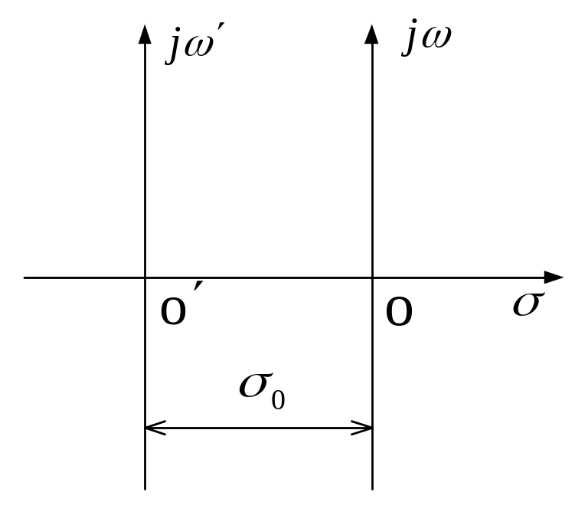
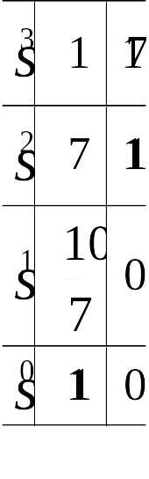
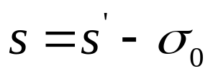
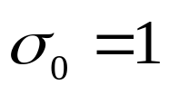

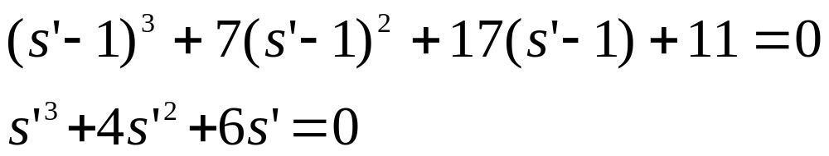
Application of Routh-Hurwitz Criterion
Estimate the stability margin
Set ，if ，substitute into the characteristic equation。

Slide 21
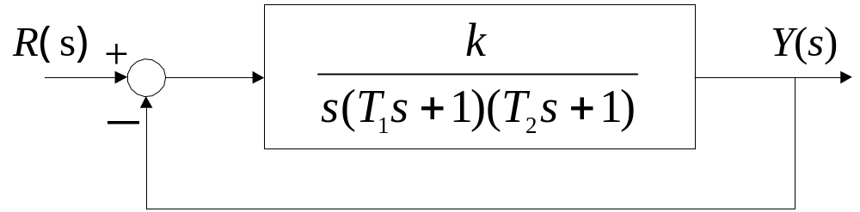
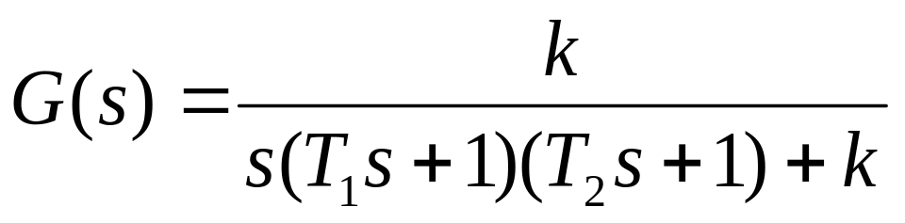
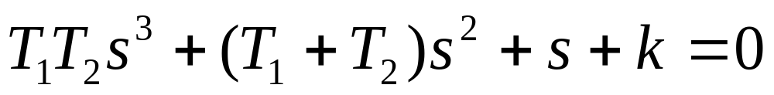
Application of Routh-Hurwitz Criterion
Determine the stability region of parameters

Slide 22
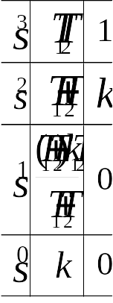
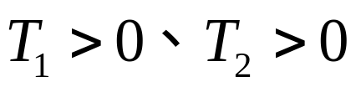
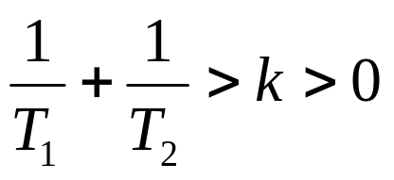
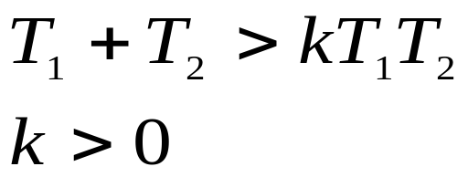
Application of Routh-Hurwitz Criterion

Slide 23
Next Milestone
Steady-state performance
  Definition of time response;
  Typical test signals;
  Performance specifications of steady-state response – steady-state error;
  Impact of disturbance to steady-state error;
  Impact of parameter variation to steady-state error.

Slide 24
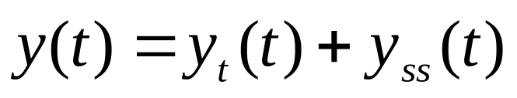
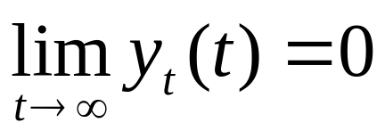
Time Response
Time Response: the state and output responses with respect to time.
The transient response and the steady-state response
Transient response is defined as the part of the time response that goes to zero as time goes to infinity
Steady-state response is the part of the total response that remains after the transient has died out

Slide 25
Remarks
All real stable control systems exhibit transient phenomena to some extend before the steady state is reached.
The steady-state response of a control system is also very important, since it indicates where the system output ends up at when time becomes large.
The study of a control system in the time domain essentially involves the evaluation of the transient and steady-state responses of the system.
In the design problem, specifications are usually given in terms of the transient and steady-state performances, and controllers are designed so that the specifications are all met by the designed system.
Notes:
All real stable control systems exhibit transient phenomena to some extend before the steady state is reached. Since inertia, mass, and inductance are unavoidable in physical systems, the responses of a typical control system can not follow sudden changes in the input instantaneously, and transients are usually observed. Therefore, the control of the transient response is necessarily important, as it is a significant behavior of the system; and the deviation between the output response and the input or the desired response, before the steady state is reached, must be closely controlled.
The steady-state response of a control system is also very important, since it indicates where the system output ends up at when time becomes large. For a position control system, the steady-state position gives an indication of the final accuracy of the system. In general, if the steady-state response of the output does not agree with the desired reference exactly, the system is said to have a steady-state error.
The study of a control system in the time domain essentially involves the evaluation of the transient and steady-state responses of the system. In the design problem, specifications are usually given in terms of the transient and steady-state performances, and controllers are designed so that the specifications are all met by the designed system.
3 In the following lessons, we are going to discuss the performances of a system in its steady-state and transient response.

Slide 26
Typical Test Signals
Response to what?
  Inputs
What’s the problem?
  The inputs to many practical control systems are not exactly known ahead of time. It is difficult to design a control system so that it will perform satisfactorily for all possible forms of input signals.
How to solve the problem?
  To assume some basic types of test inputs so that the performance of a system can be evaluated.
Notes:
The inputs to many practical control systems are not exactly known ahead of time. This poses a problem for the designer, since it is difficult to design a control system so that it will perform satisfactorily for all possible forms of input signals.
By selecting these basic test signals properly, not only is the mathematical treatment of the problem systematized, but the response due to these inputs allows prediction of the system’s performance to other more complex inputs.
In the design problem, performance criteria may be specified with respect to these test signals so that the system may be designed to meet these criteria. This approach is particular useful for linear systems, since the response to complex signals can be determined by superposing those due to simple test signals.

Slide 27
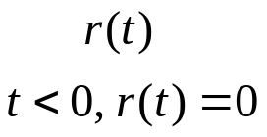

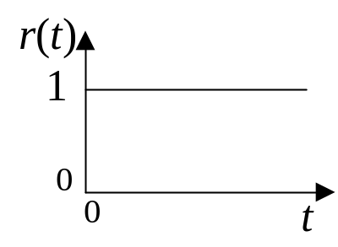
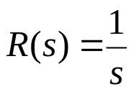

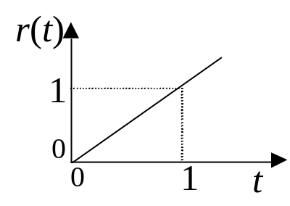
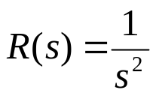

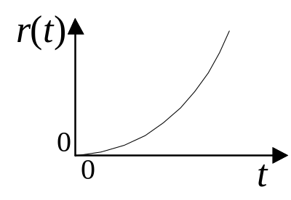
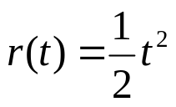

Typical Test Signals
Test signal
Step-function
Ramp-function
Parabolic-function
Notes:
The step function is very useful as a test signal since its initial instantaneous jump in amplitude reveals a great deal about a system’s quickness in responding to inputs with abrupt changes.
The ramp function is a signal that changes constantly with time. The ramp function has the ability to test how the system would respond to a signal that changes linearly with time.
The parabolic function represents a signal that is one order faster than the ramp function.
From the step function to the parabolic function, the signals become progressively faster with respect to time.
Theoretically, we can define signals with still higher rates. However, in reality, we seldom find it necessary or feasible to use a test signal faster than a parabolic function.

Slide 28
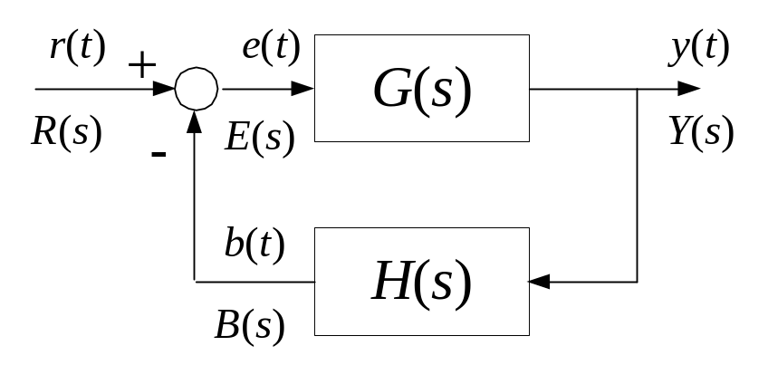


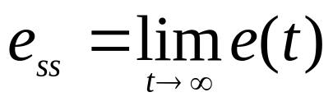
An Important Performance Specification of Steady-state Response - Steady-state Error
Defined by output:
Defined by input:
In reality, when time lasts more than 4~5 times of the time constant of the system, we can think that the steady-state is reached.

Slide 29
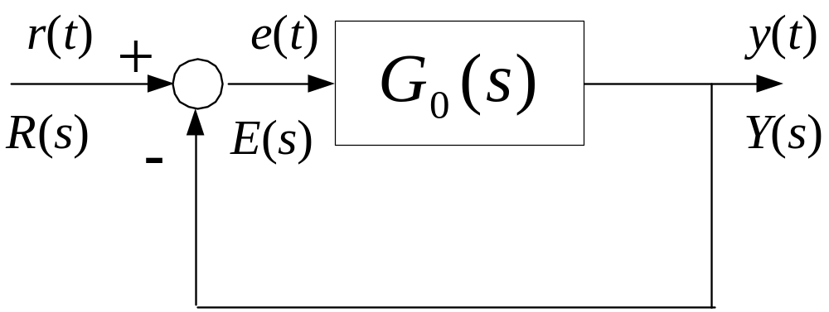

Steady-state Error
For unit feedback system:
Notes:
The input and output have the same dimension

Slide 30







Calculation of the Steady-state Error
Laplace Final-value Theorem:
If the Laplace transform of
is
, and if
does
not have any pole whose real part is zero or positive, then
Notes:
1. The denominator of sE(s) is the same as that of the system’s close-loop transfer function. So, if sE(s) does not have any pole whose real part is zero or positive, the close-loop transfer function of the system dose not have any pole whose real part is zero or positive. That means the system is stable. In another word, it is necessary to check the stability of a system before calculating its final value.

Slide 31








Example - find the final value of the following systems
(1)
(2)
(1)
(2)
Laplace final-value theorem is not applicable.

Slide 32

Type of Control Systems
Clearly,
depends on the characteristics of G₀(s).
More specifically,
depends on the number of poles
that G₀(s) has at s=0. The number is known as the
type of the control system.

Slide 33







Type of Unity-Feedback Systems
In general, G₀(s) can be expressed for convenience as:
is the open loop gain
The system order
Type 0
Type 1
Type 2
Notes:
Rational fraction. Time constant expression. Zeros and poles expression.

Slide 34



Steady-State Error of a System with a Step Input
Laplace transform of the step function:
Steady-state error of a closed loop control system:

Slide 35





Steady-State Error of a System with a Step Input
If set:
is named as step-error constant
Type 0 system
Type 1 or higher system

Slide 36



Steady-State Error of System with a Step-Input
1.4
Step Response
s=tf('s');
g0=20/((2*s+1)*(0.1*s+1));
sys=feedback(g0,1);
t=0:0.01:1.2;
step(sys,'r',t);
Td=1*(t>=0);
hold on;
plot(t,Td,'b');
grid on;
1.2
1
0.8
Amplitude
0.6
0.4
0.2
0
0
0.2
0.4
0.6
0.8
1
1.2
Time (sec)

Slide 37


Steady-State Error of System with a Step-Input
1.4
Step Response
s=tf('s');
g0=100/(s*(s+10));
sys=feedback(g0,1);
t=0:0.01:1;
step(sys,'r',t);
Td=1*(t>=0);
hold on;
plot(t,Td,'b');
grid on;
1.2
1
0.8
Amplitude
0.6
0.4
0.2
0
0
0.2
0.4
0.6
0.8
1
1.2
Time (sec)

Slide 38
Example
A system with zero steady-state error is not necessarily to be
a system without errors in transient.
Input is a square waveform
s=tf('s');
g0=100/(s*(s+10));
sys=feedback(g0,1);
t=0:0.1:10;
Td=1*((t>0 & t<2) |( t>4 & t<6) | t>8) ;
lsim (sys,'r', Td, t);
axis([0 10 -1 2]);
grid on;
hold on;
plot(t,Td,'b');
2
Linear Simulation Results
1.5
1
Amplitude
0.5
0
-0.5
-1
0
1
2
3
4
5
6
7
8
9
10
Time (sec)

Slide 39



Steady-State Error of a System with Ramp Input
Laplace transform of the ramp function:
Steady-state error of a closed loop control system:

Slide 40






Steady-State Error of a System with Ramp Input
If set:
is named as ramp-error constant
Type 0 system
Type 1 system
Type 2 or higher system

Slide 41


Steady-State Error of System with a Ramp Input
6
Linear Simulation Results
s=tf('s');
g0=20/(s*(s+10));
sys=feedback(g0,1);
t=0:0.1:6;
u1=t;
lsim(sys,'r',u1,t);
hold on;
plot(t,u1,'b');
grid on;
5
4
Amplitude
3
2
1
0
0
1
2
3
4
5
6
Time (sec)

Slide 42


Steady-State Error of System with a Ramp Input
6
Linear Simulation Results
s=tf('s');
g0=2*(s+1)/(s^2*(0.1*s+1));
sys=feedback(g0,1);
t=0:0.1:6;
u1=t;
lsim(sys,'r',u1,t);
hold on;
plot(t,u1,'b');
grid on;
5
4
3
Amplitude
2
1
0
0
1
2
3
4
5
6
Time (sec)

Slide 43





Example - find the final value of the following system with the given inputs
R
(
s
)
+
E
(
s
)
Y
(
s
)
(1)
-
(2)
A: first, check the stability of the system. The TF of the system is:
The system is stable when k>0.

Slide 44








(1) When the input is
Laplace final value theorem is not applicable
coincidence
(2) When input is
Laplace final-value theorem is not applicable.
Other method should be used.

Slide 45





Close-loop TF from R(s) to E(s)
where

Slide 46




Disturbances
Disturbances are from two origins
  Inside
    Nonlinearity
    Parameter variation
  Outside
    Environment

Slide 47

Disturbances
Disturbances are from outside environment
TF from D(s) to E(s):
How do the different blocks act on the disturbances?

Slide 48






Disturbances
Set the disturbance as:
TF of the disturbances:
Conclusion on how to attenuate the impact of disturbances
Increase the gain of the controller before the disturbances;
Add integration block in the controller before the disturbances;

Slide 49




Composite Control to Disturbances
Ideally:

Slide 50


Example - 3.11
Q: when the input r(t)=t, the disturbance d(t)=0.5*1(t), please find the steady-state error of the given system, where the error is defined as e(t)=r(t)-y(t).
A: the output is determined by both the input and the disturbance. Superposition
principle should be used here to calculate the output.
the TF from input to output
The system is stable.

Slide 51



the TF from disturbance to output
the system error:
Check poles of sE(s) and calculate the system’s steady-state error:

Slide 52
How to evaluate the impact of parameter
variation to system steady-state error?

Slide 53





Sensitivity Analysis
What does sensitivity analysis do?
  Analyze the impact of parameter variation to the control systems
+
-
Feedforward path
Feedback path
TF of the system:

Slide 54




Sensitivity of System TF to Parameter Variation in Feedforward Path
Definition:
Calculation:

Slide 55



Sensitivity of System TF to Parameter Variation
in Feedback Path
Definition:
Calculation:

Slide 56




Sensitivity of System TF to Parameter Variation
For a negative feedback system
When there exists integration block in the G(s), at steady-state
Conclusion:
negative feedback systems can effectively attenuate the impact of the parameter
variation in the feedforward path, but can do nothing to that in the feedback path.

Slide 57
Next Milestone
Transient Response
  Performance Criteria
  Transient Response of 1st-Order Systems
  Transient Response of 2nd-Order Systems

Slide 58
Transient Response
Transient response is the response of a system to a certain input which dies out as time becomes large;
For linear control systems, the characterization of the transient response is often done by use of the unit-step function as input;
The response of a control system when the input is a unit-step function is called the unit-step response.

Slide 59




Performance Criteria
Commonly used performance criteria characterizing transient response
y
(
t
)
Maximum Overshoot
Maximum Overshoot
1.0+2%
Rise Time
1.0
1.0
-
2%
Peak Time
Settling Time
0.0
t
t
t
t
r
p
s

Slide 60
Performance Criteria
Maximum Overshoot
The difference between maximum value and
the steady-state value of output.
Rise Time
Rise time is defined as the time required for the step response
to rise from zero to the final value of output. (In some other
situation, rise time is defined as the time required for the step
response to rise from 10 to 90 percent of the final value. )
Peak Time
Peak time is defined as the time required for the step response
to rise from zero to the maximum value.
Settling Time
Settling time is defined as the time required for the step
response to decrease and stay within a specified percentage
of its final value. A frequently used figure is 2%

Slide 61
Performance Criteria
Maximum Overshoot
is used to measure the relative stability of a control
system. A system with a large overshoot is usually undesirable.
Rise time
, peak time
, settling Time
are used to measure the quickness
that a system responds to the unit-step input.
The methods commonly used to study the performance of a system in transient:
Computer simulation – numerical method;
Referring to transient performance of the first-order and second order
system, estimate those of higher order systems

Slide 62







Transient Response of the 1st-Order Systems

Slide 63






Transient Response of the 2nd-Order Systems
Natural undamped frequency
Time constant, reciprocal of the natural undamped frequency
Damping ratio

Slide 64




Transient Response of the 2nd-Order Systems
Roots of the characteristic equation:
Set
Real part of the roots
Imaginary part of the roots

Slide 65











Transient Response of the 2nd-Order Systems
Relationship between the characteristic-equation roots and
and

Slide 66









Transient Response of the 2nd-Order Systems
When
the unit-step response is:
Undamped

Slide 67



Transient Response of the 2nd-Order Systems
When
the unit-step response is:
Underdamped

Slide 68



Transient Response of the 2nd-Order Systems
When
the unit-step response is:
Critically damped

Slide 69



Transient Response of the 2nd-Order Systems
When
the unit-step response is:
Overdamped

Slide 70

Step Response of Systems with Different Damping Ratios

Slide 71


Transient Response of the 2nd-Order Systems
Two useful experimental formulas to estimate the maximum overshoot and settling time of the step response of 2nd-order under damped systems
Notes:
The exactly analytical description of the settling time is difficult to obtain. We can obtain an approximation of the settling time by using the envelope of the damped sinusoid of y(t).

Slide 72






Example
Q: please find the maximum overshoot and settling time of the following system.
where
A:
s=tf('s');
z=0.3;
g=1/(s^2+2*s*z+1);
step(g,20)
grid on

Slide 73

Relationship Between the Damping Ratio and the Maximum Overshoot
ζ↑ σ％↓

Slide 74

Relationship Between the Damping Ratio and the Settling Time
Actual
Estimated

Slide 75

Relationship Between the Natural Undamped Frequency and Other Criteria

Slide 76







Example
Q: please design a second-order system with a damping ratio equal to 0.707
and a settling time equal to 0.5s. Find the poles of the system and calculate its
natural undamped frequency.
A: because
and
j
ω
s
Then
1
According to
we can get
0
45
σ
-
ζ ω
Therefore
n
s
2

Slide 77
Wrap-up
Stability
  S&N Conditions for System Stability
  Routh-Hurwitz Criterion
  Definition of time response;
  Typical test signals;
  Performance specifications of steady-state response – steady-state error;
  Impact of disturbance to steady-state error;
  Impact of parameter variation to steady-state error.
Transient Response
  Performance Criteria
  Transient Response of 1st-Order Systems
  Transient Response of 2nd-Order Systems

Slide 78
Assignment
Page 71
4，(3)， (4)
5，(2)
8, (1), (2), (3)
Page 72
  9，(4)
  10，11，12

